Slide 1

IT 353 Web Development Technologies
Jianwei Lai
jlai12@ilstu.edu

Slide 2
Today’s Content
jQuery Traversing
jQuery Filters

Slide 3
jQuery Traversing
jQuery traversing, which means "move through", are used to "find" (or select) HTML elements based on their relation to other elements.
Start with one selection and move through that selection until you reach the elements you desire.
$( function() {});
Short for
$(document).ready(function() { ... });
Notes:
https://www.w3schools.com/jquery/jquery_traversing.asp

Slide 4
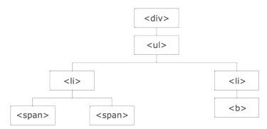
Illustration explained:
The <div> element is the parent of <ul>, and an ancestor of everything inside of it
The <ul> element is the parent of both <li> elements, and a child of <div>
The left <li> element is the parent of <span>, child of <ul> and a descendant of <div>
The <span> element is a child of the left <li> and a descendant of <ul> and <div>
The two <li> elements are siblings (they share the same parent)
The right <li> element is the parent of <b>, child of <ul> and a descendant of <div>
The <b> element is a child of the right <li> and a descendant of <ul> and <div>
Notes:
Treat dom like a family tree

Slide 5
Three useful jQuery methods for traversing up the DOM tree are:
parent()
parents()
parentsUntil()

Slide 6
jQuery parent() Method
The parent() method returns the direct parent element of the selected element.
This method only traverse a single level up the DOM tree.
https://www.w3schools.com/jquery/tryit.asp?filename=tryjquery_parent
Notes:
Change to $("p span") to see the difference
How to get the span li parent only?
$("li span").
Will $("div span") select anything both? Or none or one?
Will $("div > span") select anything?
Will $("li > span") select anything?

Slide 7
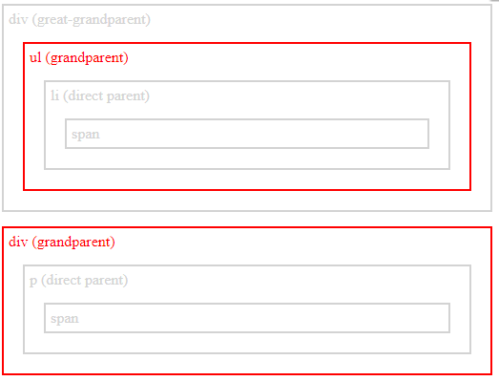
Question: How to get the grandparent?

Slide 8
jQuery parents() Method
The parents() method returns all ancestor elements of the selected element, all the way up to the document's root element (<html>).
https://www.w3schools.com/jquery/tryit.asp?filename=tryjquery_parents
Notes:
An equivalent selector in css
$(":has(span)")
$(":has(> span)")
Can not have a space after “has”
You may ask the question. If we can select things with css seletors, why need jquery methods?
:has in the new version of css slector https://drafts.csswg.org/selectors-4/#relational still work in progress
It may not support by some browsers

Slide 9
jQuery parentsUntil() Method
The parentsUntil() method returns all ancestor elements between two given arguments.
https://www.w3schools.com/jquery/tryit.asp?filename=tryjquery_parentsuntil
Notes:
$("li span").parentsUntil("div")
$(“ul span").parentsUntil("div")
Will $(“ul > span").parentsUntil("div") work?
Will $("li > span").parentsUntil("div") work?

Slide 10
Traversing Down the DOM Tree
children()
find()

Slide 11
jQuery children() Method
The children() method returns all direct children of the selected element.
This method only traverse a single level down the DOM tree.
https://www.w3schools.com/jquery/tryit.asp?filename=tryjquery_children
Notes:
Be careful with the css string, adding a space between 2 px won’t work.
css({"color": "red", "border": "2px solid red"});

Slide 12
jQuery find() Method
The find() method returns descendant elements of the selected element, all the way down to the last descendant.
https://www.w3schools.com/jquery/tryit.asp?filename=tryjquery_find
Notes:
If I do not want to use the find method, how should I change the css selector?
$("div span").css({"color": "red", "border": "2px solid red"});
Will $(“p span") work?
var a = "span";
$("div").find(a).css({"color": "red", "border": "2px solid red"});
Copy and paste the span twice. How to get the second child?
:nth-child()
$("div span:nth-child(2)")
How to do it in jQuery
$($("div").find("span")[0]).css({"color": "red", "border": "2px solid red"});

Slide 13
How to search with keyword?
contains()- Select all elements that contain the specified text.
https://www.w3schools.com/jquery/tryit.asp?filename=tryjquery_sel_contains
Check contains here
https://api.jquery.com/contains-selector/

Slide 14
each() method
Iterate over a jQuery object, executing a function for each matched element.
Check the example form.html
Question: can we use a method to replace show and hide methods?
Question: how to make it not-case sensitive?
Check each() here
https://api.jquery.com/each/
Notes:
Check the example form.html
if (a)
$(this).show();
else
$(this).hide();
$(this).toggle(a);
.toLowerCase()

Slide 15
Traversing Sideways in The DOM Tree
siblings()- returns all sibling elements of the selected element.
next()
nextAll()
nextUntil()
prev()
prevAll()
prevUntil()
https://www.w3schools.com/jquery/tryit.asp?filename=tryjquery_siblings2

Slide 16
jQuery Filtering
first()- returns the first element of the specified elements
last()- returns the last element of the specified elements
eq()- returns an element with a specific index number of the selected elements.
https://www.w3schools.com/jquery/tryit.asp?filename=tryjquery_eq
Notes:
Eqivalent css method $("p:nth-of-type(2)")
:nth-of-type() CSS pseudo-class matches elements of a given type (tag name), based on their position among a group of siblings.
:nth-child() CSS pseudo-class matches elements based on their position in a group of siblings.
Difference between the two https://css-tricks.com/the-difference-between-nth-child-and-nth-of-type/

Slide 17
jQuery Filtering
filter()-Elements that do not match the criteria are removed from the selection, and those that match will be returned.
not()
https://www.w3schools.com/jquery/tryit.asp?filename=tryjquery_filter
Notes:
Change filter to not to see the difference
How can we use css selector to do the same thing?
$("p:not(.intro)")

Slide 18
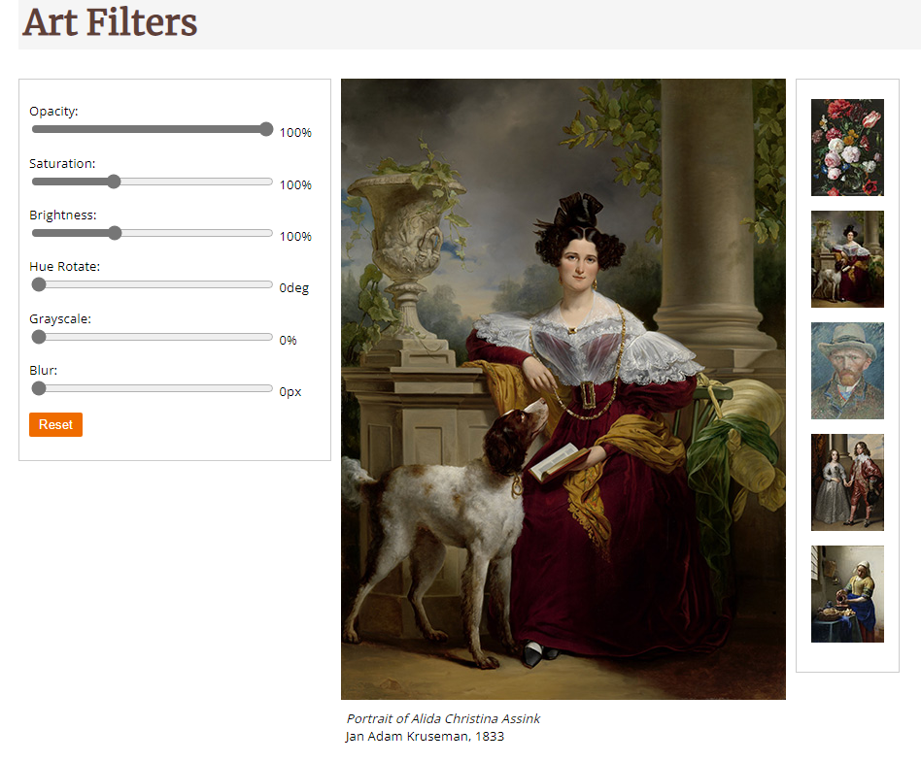

Slide 19
Step 1: refer to thumbnails
$("#thumbBox img").on("click", function (e) {
}

Slide 20
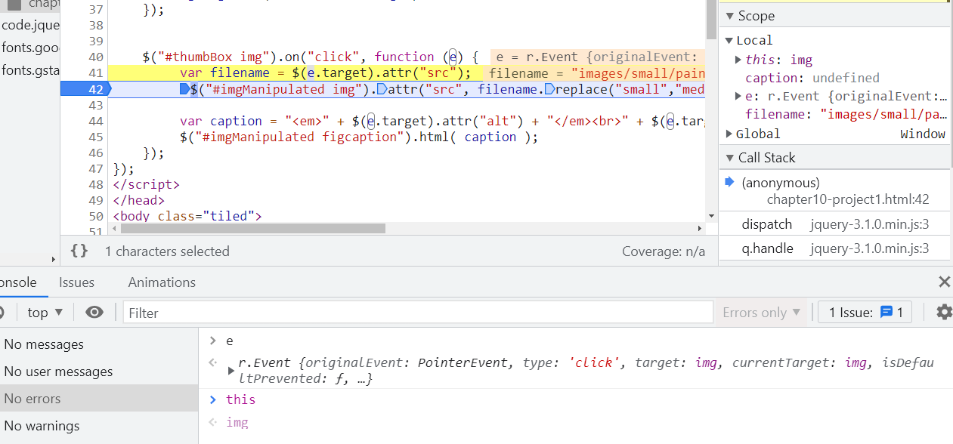
Step 2: when a thumbnail is clicked, get its src attribute
var filename = $(e.target).attr("src");
Question:
Can I change e.target to this?
Check the e.target in Google DevTools to see if they are the same

Slide 21
Step 3: replace “small” with “medium” in the src path
var bigpic= filename.replace("small","medium"));

Slide 22
Step 4: change the “src” of the big picture
$("#imgManipulated img").attr("src", bigpic);

Slide 23
Question: how to change the caption for the big picture
Hint: where can you get the caption information for the big picture from the thumbnails?
Notes:
$("#thumbBox img").on("click", function (e) {
var filename = $(e.target).attr("src");
$("#imgManipulated img").attr("src", filename.replace("small","medium"));
var caption = "<em>" + $(e.target).attr("alt") + "</em><br>" + $(e.target).attr("title");
$("#imgManipulated figcaption").html( caption );
});
Imagine you need to use javascript to do it! How much more code you need!?

Slide 24
Reminder
The in-class exercise 3 due in two days
Only need to make the sliders work
No need to worry about the thumbnails

